Slide 1

Sales Pipeline Intelligence: From Data to Decision
Project Goal: Maximize Win Rate & Optimize Sales Resources
Presented
By
Elisha Bassey
Data Analyst | Turning complex data into clear, actionable business stories
Tools: Power BI | SQL | Python | CRM Pipeline Dataset

Slide 2
Powering Spota's Sales Growth: The Data Mandate
The Challenge: Spota is busy closing lots of deals, but we waste time on deals that are too small or likely to fail.
Project Goal: Use our sales data to help our team stop guessing and start focusing on the right deals at the right time.
The Main Questions This Project Answers
Descriptive Answer (The 'What'): Where do we win most often (countries/industries) and which agent/managers are the best at closing deals?
Predictive Answer (The 'How/Why'): Which active deals are currently most likely to fail, and what is the biggest process mistake we must fix to win more deals overall?

Slide 3
Methodology: How We Got the Answers
From Raw Data to Risk Scorecard
Source: Historical and Active Sales Deals from our central CRM database.
Key Information: Close Value, Agent/Manager, Account, Sector, Region, and Deal Stage
Size: Over 8,300 closed and active opportunities, excluding 500 prospecting deals
Tool | Purpose in Project | Output
SQL | Extraction: Securely pulled the raw data and performed initial filtering. | Clean Deal Data
Python | Analysis & Modeling: Cleaned the data, created new features (like Win Rates and Deal Duration), and built the Risk Scorecard model. | Top 3 Risk Factors
Power BI | Visualization: Created the dashboards and descriptive charts for our "What" and "Where" insights. | Key Descriptive Insights

Slide 4
Executive Summary & Core Challenge
Pipeline Health: Strong Growth, But a Critical Problem
The Good News (What the Numbers Show)
Metric | Result | Trend
Win Rate | 63.15% | We close most of the deals we chase.
Opportunities | + 37% MoM | Our list of potential deals is growing.
Total Revenue | +12.8% MoM | We are making more money month over month.
The Critical Problem
Deal Size is Dipping ( - 0.8% MoM): We are celebrating many small wins, which is good, but it means we are spending too much time on low-value deals instead of big, important clients.

Slide 5
Key Descriptive Insights
Where We Win and the Best Performance
The Drivers of Success (Place and People)
Geography: The United States is the biggest source of revenue with over 45% of the total revenue.
Sector: The Retail Sector brings in the most value consistently, leading with over 1.4k opportunities
Talent: Hayden, Reed, and Darcel are the Tops number 1 Agents based on Success rate, conversion rate and most Revenue respectively.
Strategic Implication for Spota
Protect What Works: Keep focusing strongly on the US Retail market.
Share the Knowledge: Find out exactly what our top managers do and teach it to everyone else to improve overall performance.

Slide 6
The Predictive Model as an Insight Engine
The Sales Risk Scorecard
Goal: We built a model to find Hidden Risks and Best Opportunities to fix our process.
Metric | Value | What It Means
Accuracy | ~60% | The model can't perfectly predict a win/loss alone.
AUC Score | 91% | The model is excellent at ranking deals by risk (high vs. low).
What the Model Delivers
It is a Risk Scorecard. It gives every active deal a score (0-100%) showing how much it looks like a deal we usually lose.
This score allows managers to decide where to focus their limited time and resources for maximum impact.

Slide 7
Model Drivers: Our Top 3 Process Flaws
What Really Causes a Deal to Fail?
Top 3 Critical Risk Factors
Deal Duration (Time): This is the number 1 problem. Deals that sit around too long are almost always lost. Risk: We let deals stall and lose momentum.
Agent Win Rate (Skill): The individual agent's track record is highly predictive. Success is concentrated in specific people. Risk: Sales performance depends too much on individual talent, not a repeatable system.
Product Win Rate (Portfolio): Success varies significantly by the product being sold. Risk: Certain products or their sales strategies are not effective.
Insight to Action
We must focus on faster execution and scaling the skills of our top agents across the team.

Slide 8
Actionable Strategy
Predictive Intervention: Focus on the Riskiest 77 Deals
We are going to fix the process by prioritizing our time based on confidence.
Confidence Level | Deals (N=1589) | Strategic Action
High (>70%) | 905 Deals | Automate & Trust: These deals are almost certain to close. Track them, but don't waste management time.
Medium (50-70%) | 607 Deals | Focused Review: Manager checks the Top 3 Risk Factors (Duration, Agent Skill, Product).
Low (<50%) | 77 Deals | RED FLAG INTERVENE NOW: These 77 deals are our biggest risk. Immediately assign senior support to salvage or qualify out quickly.
Conclusion: The system tells us exactly where to put our most valuable resources to prevent the most likely losses.

Slide 9
General Recommendations: A Strategic Roadmap
Combining Data: Three Pillars of Growth
Strategic Defense & Expansion (Descriptive)
  Action: Launch a "Defend the Dominance" campaign for the US Retail sector, allocating additional marketing spend to protect our highest revenue stream.
  Goal: Secure market share and stabilize our revenue base.
Fix the Fundamental Flaw (Predictive)
  Action: Implement a Deal Duration Policy to flag any deal that sits idle past a fixed, short time window. Make "Stalled Deal" the number one metric for daily manager review.
  Goal: Stop losing deals to slow execution (our #1 risk factor).
Scale Talent and Best Practices (Descriptive + Predictive)
  Action: Document the entire sales process of our Top 20% Agents (identified by their high win rates) and turn it into the new standard training manual for all new hires.
  Goal: Reduce reliance on individual skill and institutionalize repeatable success across the entire sales team.

Slide 10
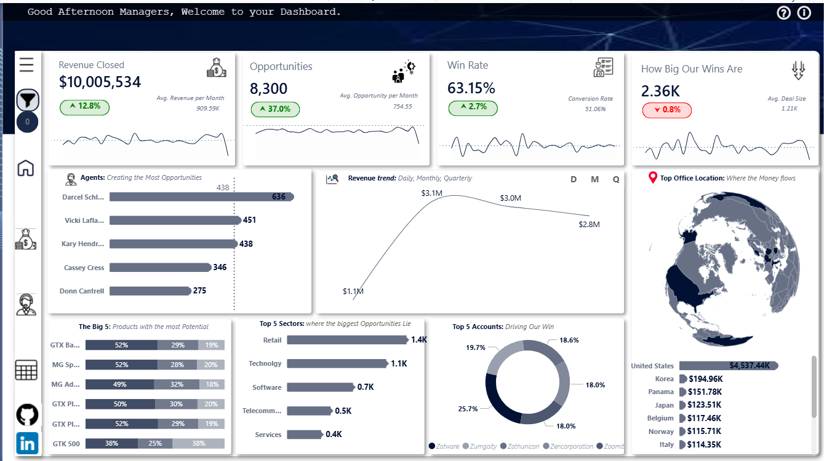
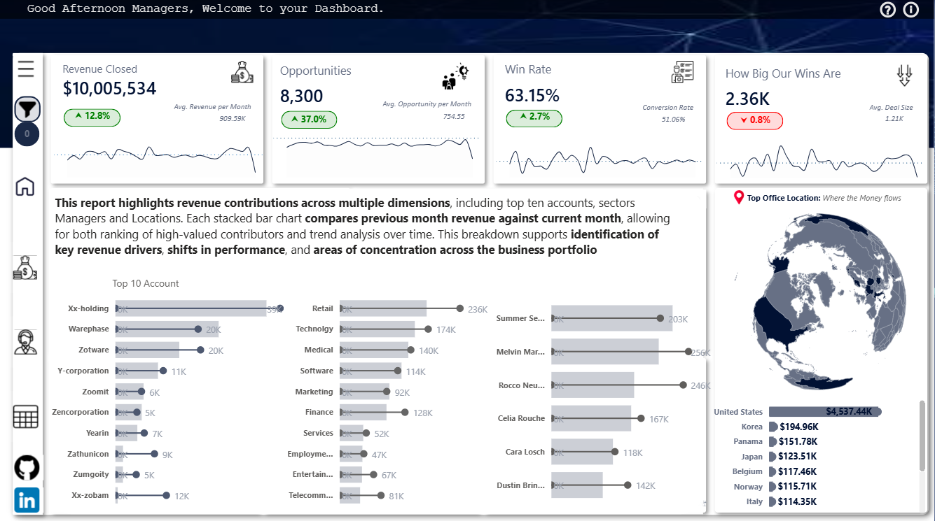
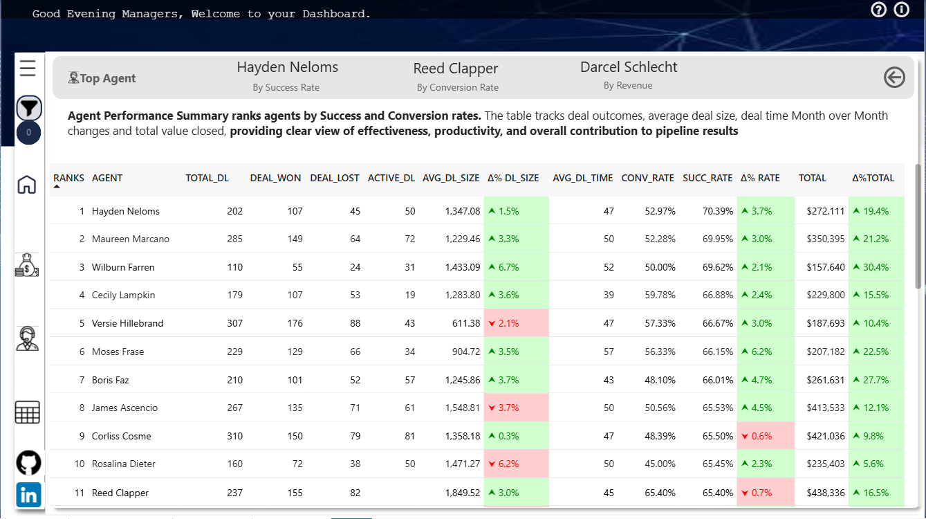
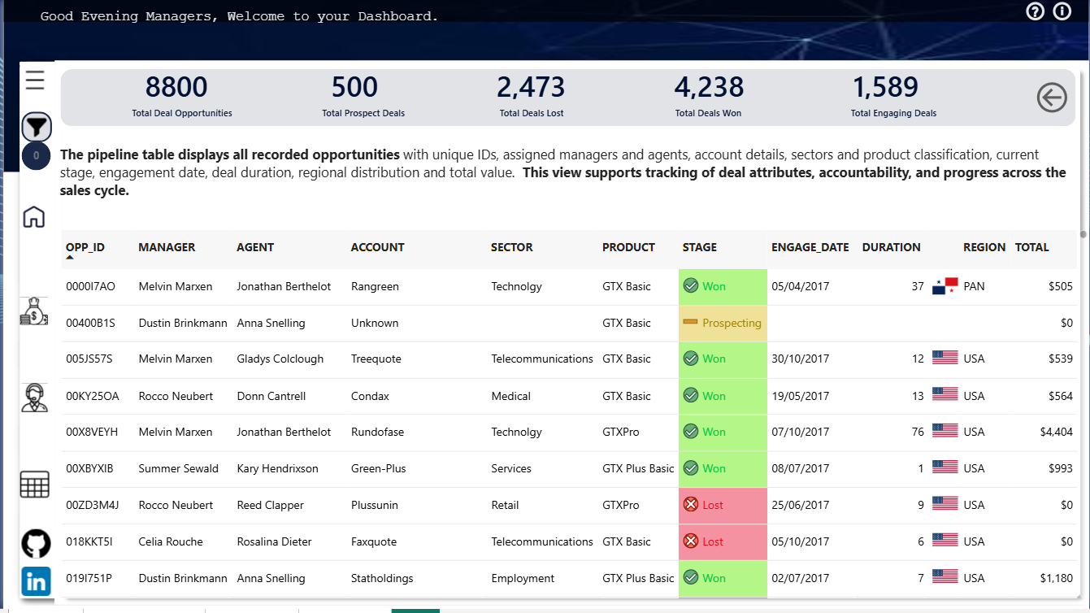
THANK YOU

Slide 12





